Slide 1
SCHEDULER
Ryan Tolentino
Miguel Castro
May 3, 2018

Slide 2
Overview
Introduction
Background
Tool & Techniques
Problem Solution
Risk Assessment
Struggles
What is next

Slide 3
Introduction
We have decided to create scheduler application that allows two individuals to schedule an activity. Our example in this case is scheduling a tea activity.

Slide 4

Background
Model View Controller Web2py separates the data representation (the model) from the data presentation (the view) and also the application logic and workflow (the controller).

Slide 5
Tools and Techniques
Web2py Web2py is a free open-source web framework for secure database web application. The application uses python and includes a database abstraction layer, therefore it knows how to generate SQL by itself.
SQLDB A database is used for a structured set of data held in the computer. In our application we will be using an SQLDB.
HTML,CSS,Javascript The view is the web applications visual appearance. The view is attached to the model and the controller and gets the data to present. The views utilize Hypertext Markup Language (HTML) Cascading Style Sheets (CSS) and a little bit of javascript to make the application more interactive.

Slide 6
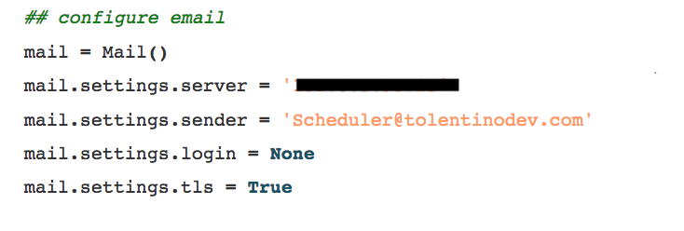
Tools and Techniques
Mail Server/SMTP This web application utilizes a single mail server to send and receive emails.

Slide 7
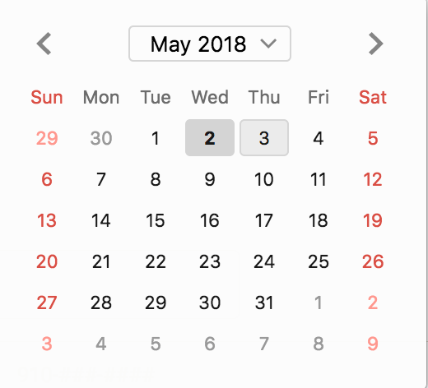
Tools and Techniques
Calendar Application Program Interface (API) Web2py allows the use of plugins and APIs. We decided to take advantage of this by utilizing a basic calendar API for ease of use.

Slide 8
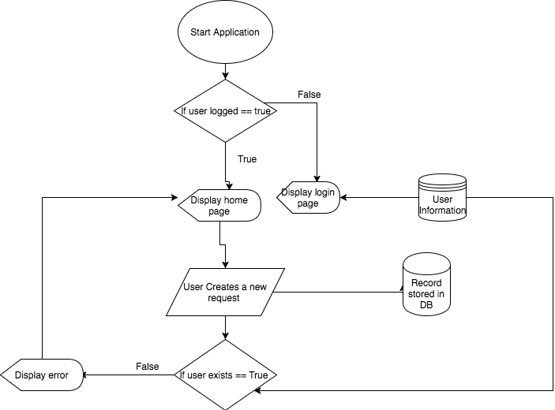
Problem Solution

Slide 9
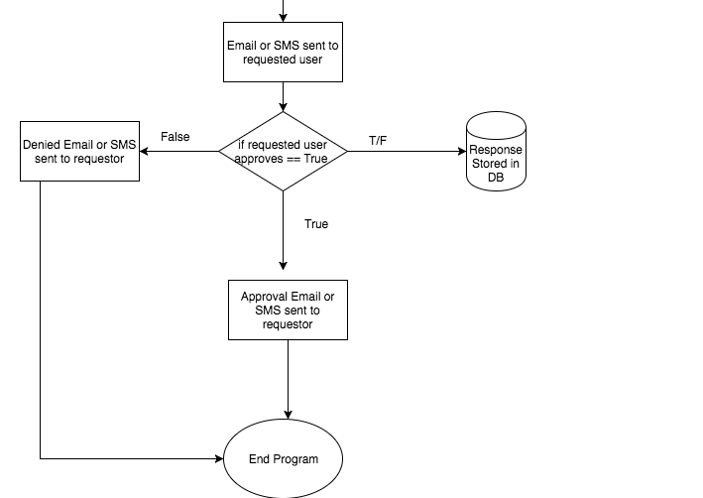
Problem Solution

Slide 10
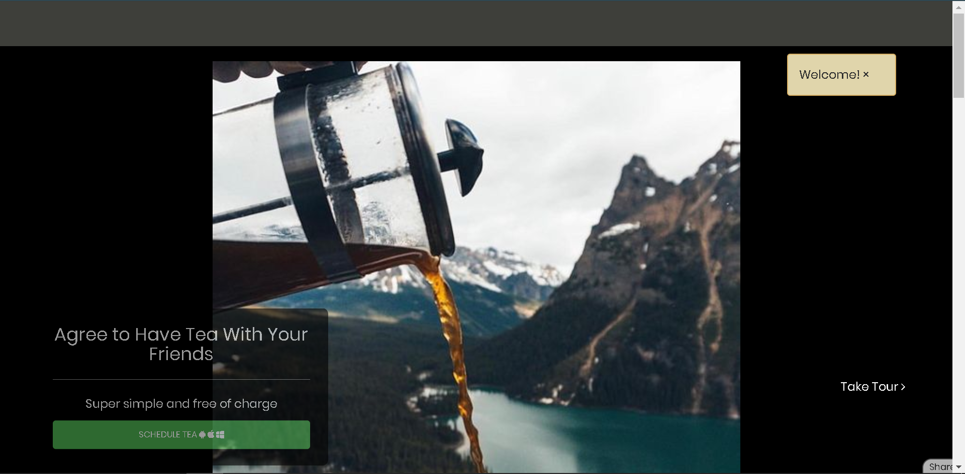
Problem Solution
This is a prototype version of our application, only shows the view mode of the Tea App

Slide 11
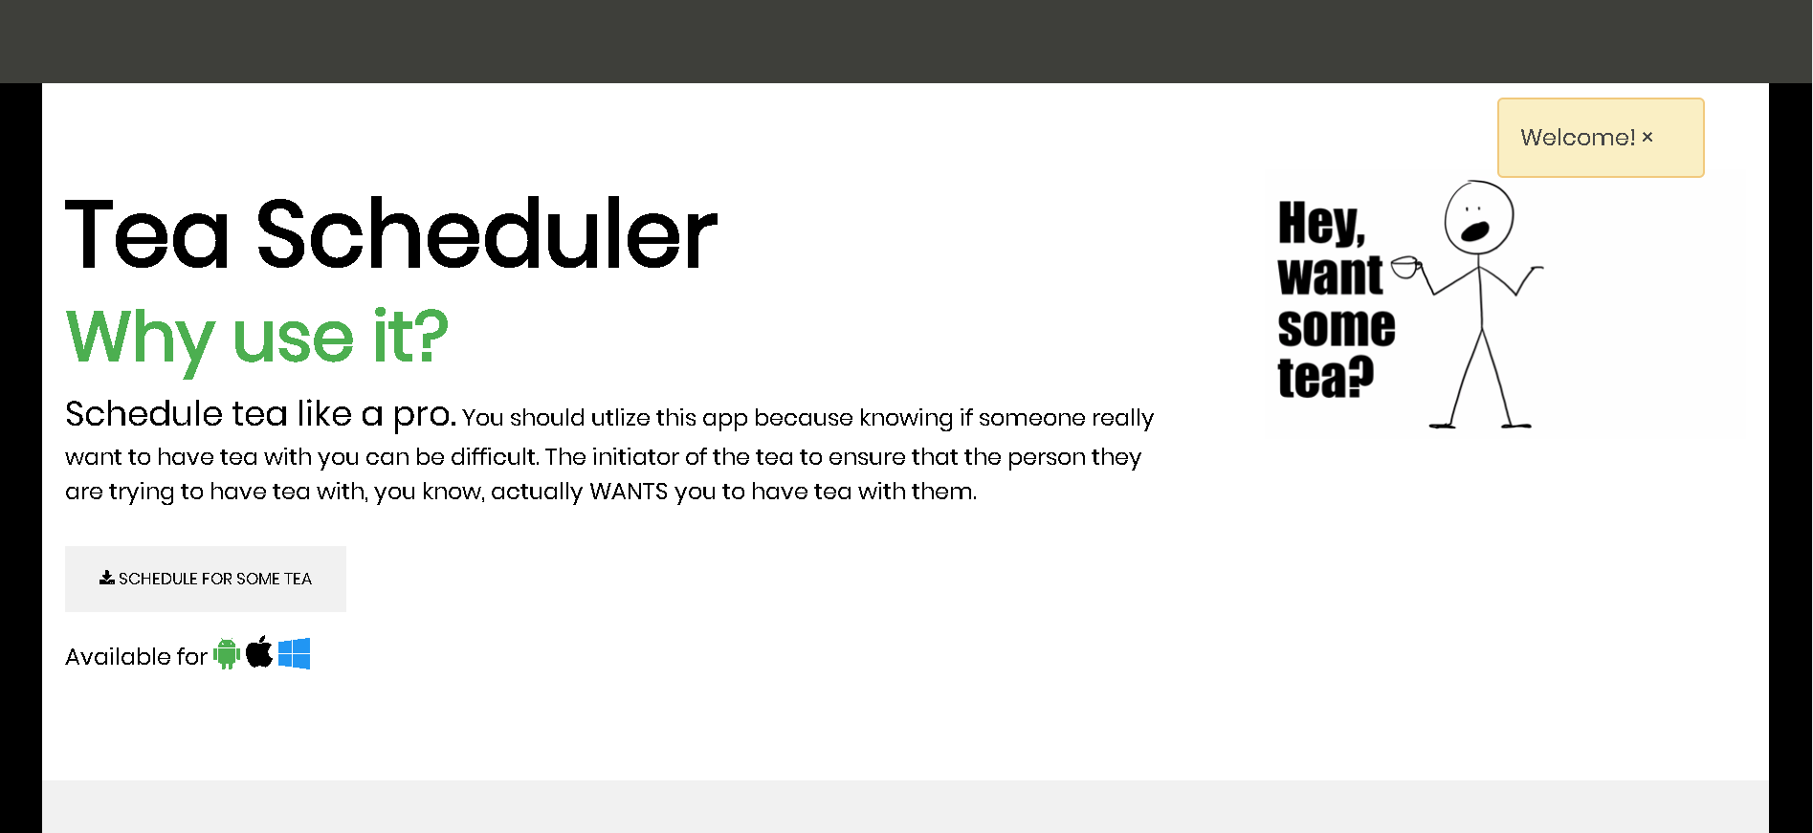
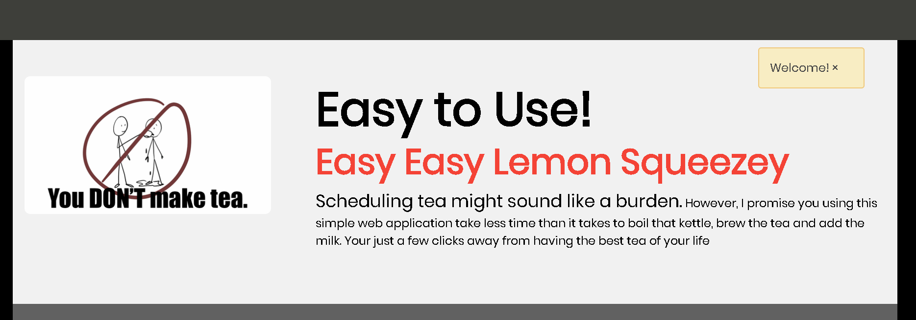
Advertisements
This is a prototype version of our application, only shows the view mode of the Tea App

Slide 12
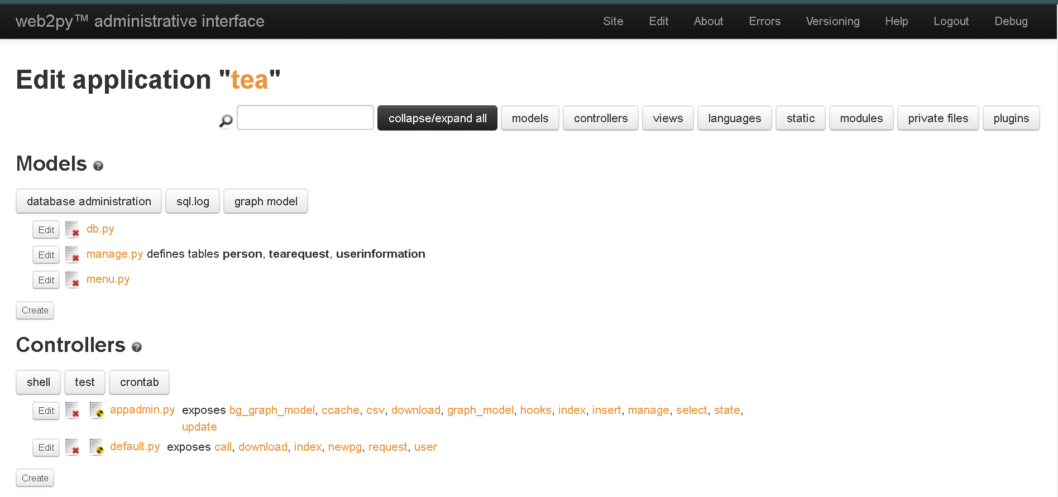
Web2py Admin Interface
This is how we edit the Tea App
It uses the concept of Model View Controller Concept
The framework uses Python, JavaScript, and HTML language

Slide 13
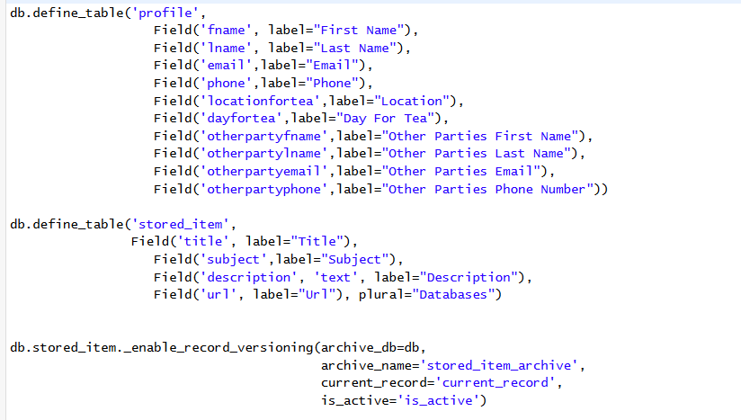
Database Model
We created a table database the defines and stored user information and tea request information
This allows us to request both of the user’s data and allow to schedule the activity

Slide 14
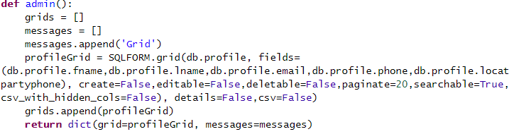
Controller
We created a controller that stores all the inputs from form
This allows us to gather both parties information and to complete the request

Slide 15

Live Demo
https://web.uncfsu.edu/tea/

Slide 16

View our code!
https://github.com/jangoflyte/Senior-Project

Slide 17

Risk Assessment
The Requestor must know the requestees contact information
Otherwise the application would not function
The Requestor and requestee must have @broncos.uncfsu.edu emails
Otherwise the mail server would not be able to deliver the email

Slide 18
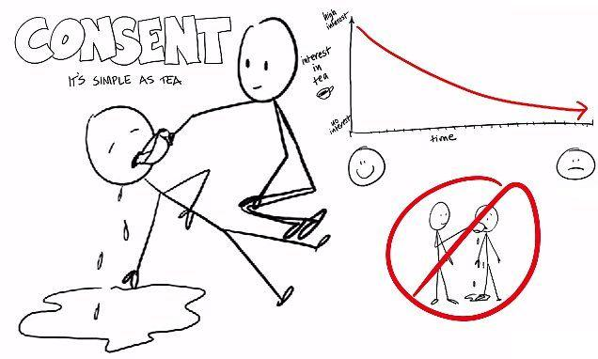
Struggles
Change of project from original topic of sexual consent because it was a “sensitive topic “ and it required special paperwork.
However, we just revised our project to be a scheduler for tea a metaphor for our original topic.

Slide 19

What is Ahead
Add SMS Messaging
Added Security for the web application such as email encryption
Allow web server to mail to other hosts
Switch to a Google Calendar API or iCloud Calendar API
Modify or improve logic within the application

Slide 20

Summary
Introduction
Background
Tool & Techniques
Problem Solution
Risk Assessment
Struggles
What is next

